Slide 1
ADABOOST REGRESSION
Boosting Algorithm for Regression

Slide 2
What is Adaboost?
Adaboost stands for Adaptive Boosting
It is a boosting ensemble algorithm
It combines multiple weak learners to form a strong model
Each new model focuses more on previous errors

Slide 3
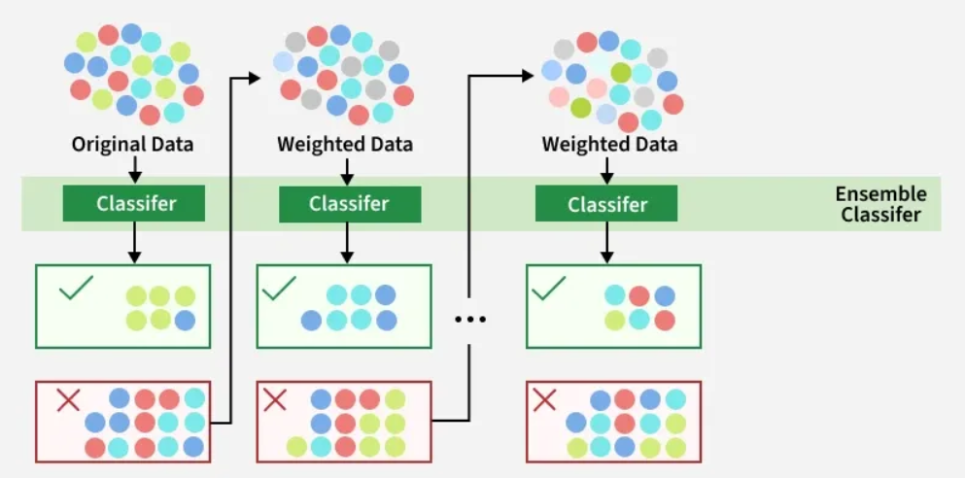
Adaboost Diagram

Slide 4
How AdaBoost Works?
First model is trained on the original data
Incorrectly predicted points get higher weight
Next model focuses more on these difficult points
Final prediction is a weighted sum of all models

Slide 5
Advantages & Limitations
Advantages:
High accuracy
Handles missing values
Built-in regularization
Limitations:
Complex to tune
Requires extra library installation

